Slide 1
Lesson 4
E115 – Programming and Data analysis

Slide 2
Lesson Objectives
At the end of the lesson, you should be able to:
Import data from text files into Excel
Clean up the data by removing blank rows and damaged data
Present the data in the appropriate charts to convey a message

Slide 3

The Data
Notes:
Need to relate the class discussion from a company point view … where lots of sales n transactions take place every second / hour / day / week / month.

Slide 4
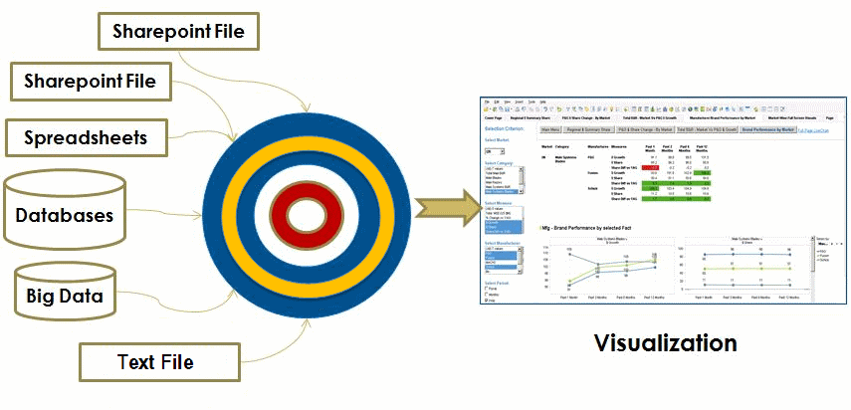
Data sources/Data formats
Notes:
Need to highlight the data consolidation from different sources of data / formats from the perspective of portability and a company with branches across the country/world, with different practices of data storing.

Slide 5
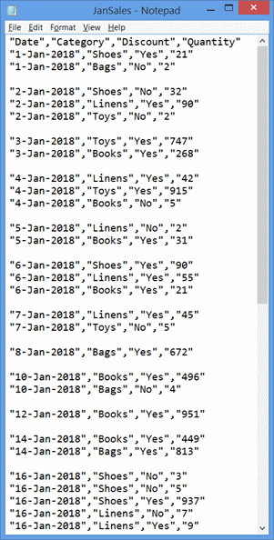
Text File
Most common format.
Easily portable across platforms.
Created in several ways.
Created using Notepad, WordPad, MS-Word, MS-Excel, etc.

Slide 6
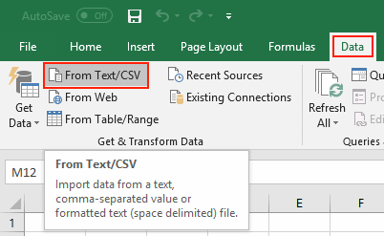
Do it with me – Import data from a text file
For Office 365 ProPlus:
Step 1: Open a blank workbook in Excel
Step 2: Click on Data → From Text/CSV

Slide 7
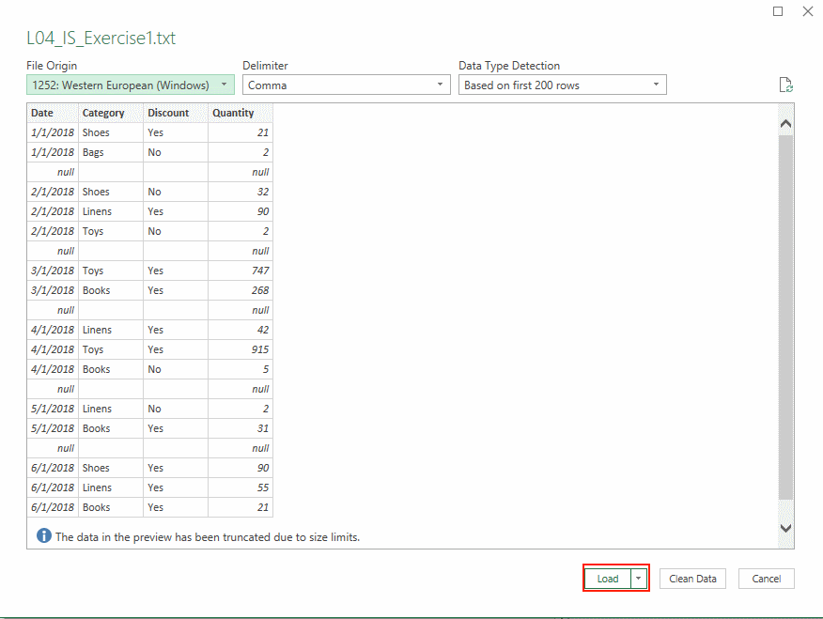
Do it with me – continued…
Step 3: Locate the file “L04_IS_Exercise1.txt” on your computer and click Load

Slide 8
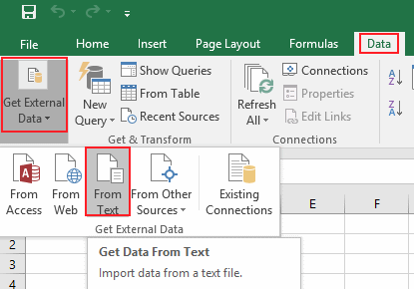
Do it with me – Import data from a text file
For Excel 2016:
Step 1: Open a blank workbook in Excel
Step 2: Click on Data → Get External Data → From Text

Slide 9
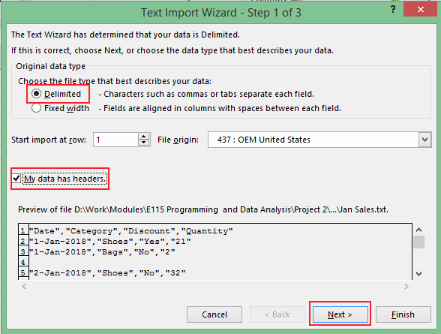
Do it with me – continued…
Step 4: Locate the file “L04_IS_Exercise1.txt” on your computer and click Import
Step 5: Choose Delimited, and check the box My data has header. Click Next.

Slide 10
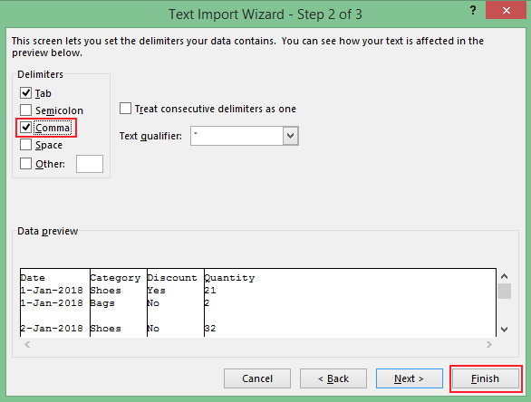
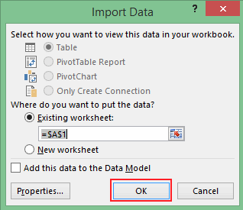
Do it with me – continued…
Step 6: Check the box Comma. Click on Finish followed by OK.

Slide 11
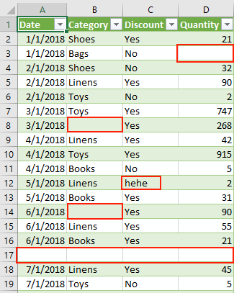
Observations
There are missing and damaged data points in the table.
This creates difficulty when we are working with the data e.g. finding last row, plotting graphs etc
Therefore next step after importing data is to clean the data.

Slide 12
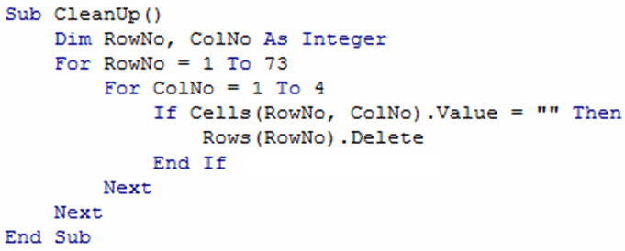
Exercise 1 – Data cleanup
Using what you have learned about “If-Else” statements and “For… Next” loops, write code that will go through the imported table and remove any rows that contain empty cells.
[Hint] Command to delete Row 5: Rows(5).Delete
Answer:

Slide 13
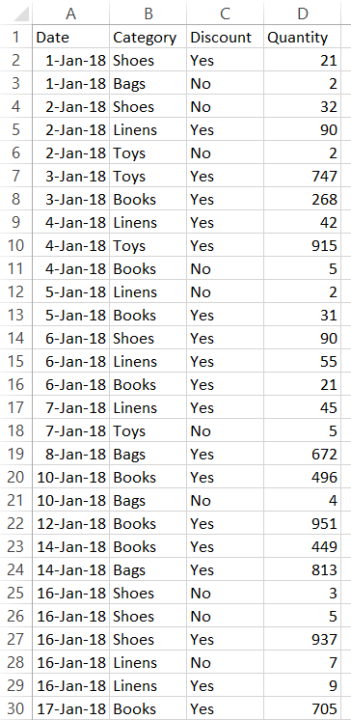
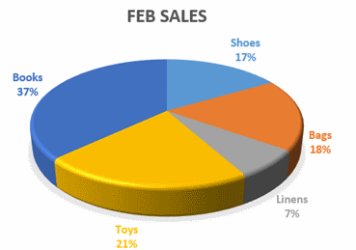
Presenting data in a meaningful way
If you are a manager trying to understand a situation based on data that has been collected, would you prefer the data to be presented to you in tabular form or graphical form? Why?

Slide 14
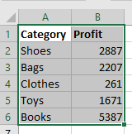
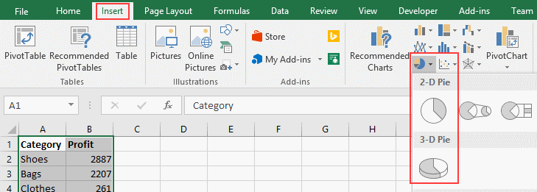
Do it with me – Manually create a chart
Step 1: Open the Excel file named “L04_IS_Exercise2.xlsx” and select the data as shown:
Step 2: From “Insert” menu, go to the Charts group and select Pie chart.
Step 3: Choose your preferred Pie Chart type.

Slide 15
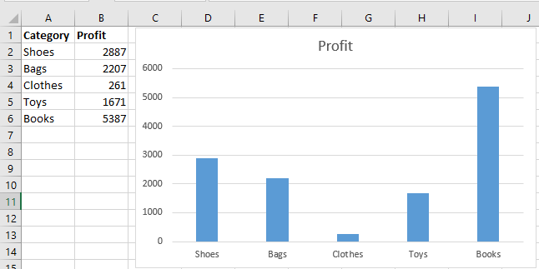
Exercise 2
Create a Bar Chart to display the profit from the different categories of items in “L04_IS_Exercise2.xlsx”. Examine the code that has been generated.

Slide 16
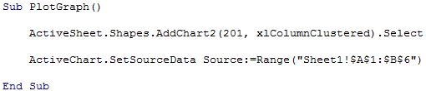
VBA code to plot chart
Add a chart into the Excel sheet (xlColumnClustered is a bar chart).
Link the chart with the cells that contain the data to be plotted (In this e.g. Cells A1 to B6 in Sheet 1).

